Slide 1
MUMBAI:
105, M.I. ESTATE, OFF. DR. E. MOSES ROAD, GANDHINAGAR, WORLI, MUMBAI - 400 018
PALGHAR:
54, KINGSTONE TOWER, KAUL'S HERITAGE CITY, VASAI (W), PALGHAR - 401201
NAVI MUMBAI:
OMKAR BRAMHA, SURVEY NO. 143/1, 144/3, 144/4, ADAI, PANVEL, DIST. RAIGAD, NAVI MUMBAI 410206
www.condesign.co.in
PROJECT BY – CONDESIGN ENGINEERS PVT. LTD.
RCC DESIGN & CONSULTANT – PROF. S. S. MUJAWAR
Reg. No. 2021/PMC/TP/1518/2021
PROJECT MANAGEMENT CONSULTANT– SES BHARAT
SPECIALIST CONTRACTOR – STRUCTOLIFE INDIA LLP
engg.condesign@yahoo.in
structolife@gmail.com
info@sesbharat.in
022 6610 0369
+91 9820640331
+91 7208122478
+91 7218786111

Slide 2
MUMBAI:
105, M.I. ESTATE, OFF. DR. E. MOSES ROAD, GANDHINAGAR, WORLI, MUMBAI - 400 018
PALGHAR:
54, KINGSTONE TOWER, KAUL'S HERITAGE CITY, VASAI (W), PALGHAR - 401201
NAVI MUMBAI:
OMKAR BRAMHA, SURVEY NO. 143/1, 144/3, 144/4, ADAI, PANVEL, DIST. RAIGAD, NAVI MUMBAI 410206
www.condesign.co.in
REPAIRS, EXPANSION & BEAUTIFICATION WORK
engg.condesign@yahoo.in
structolife@gmail.com
info@sesbharat.in
022 6610 0369
+91 9820640331
+91 7208122478
+91 7218786111

Slide 3
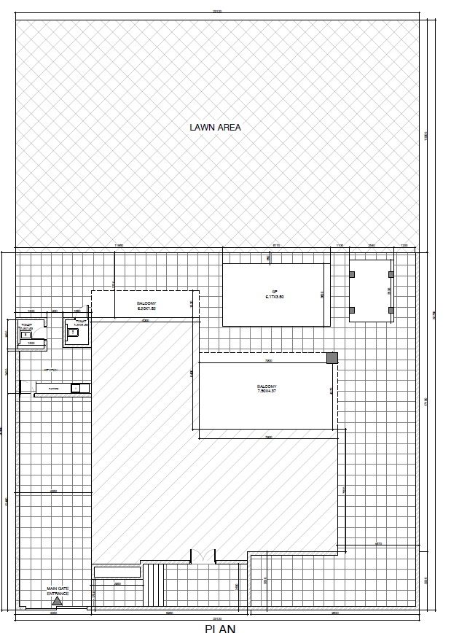
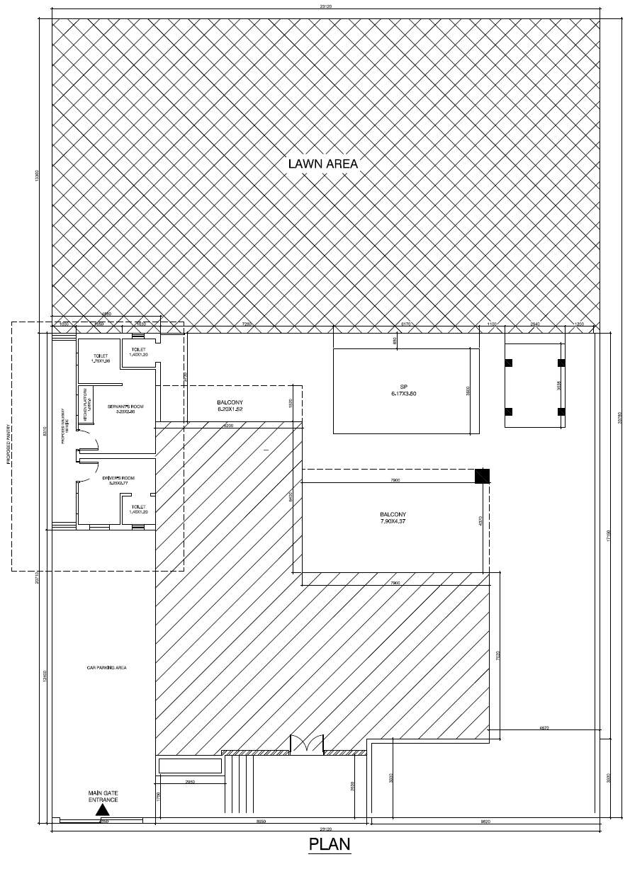
Project - b46 della lonavala
Proposed Pergola
Proposed Glass House
Existing Layout
Proposed Layout

Slide 4
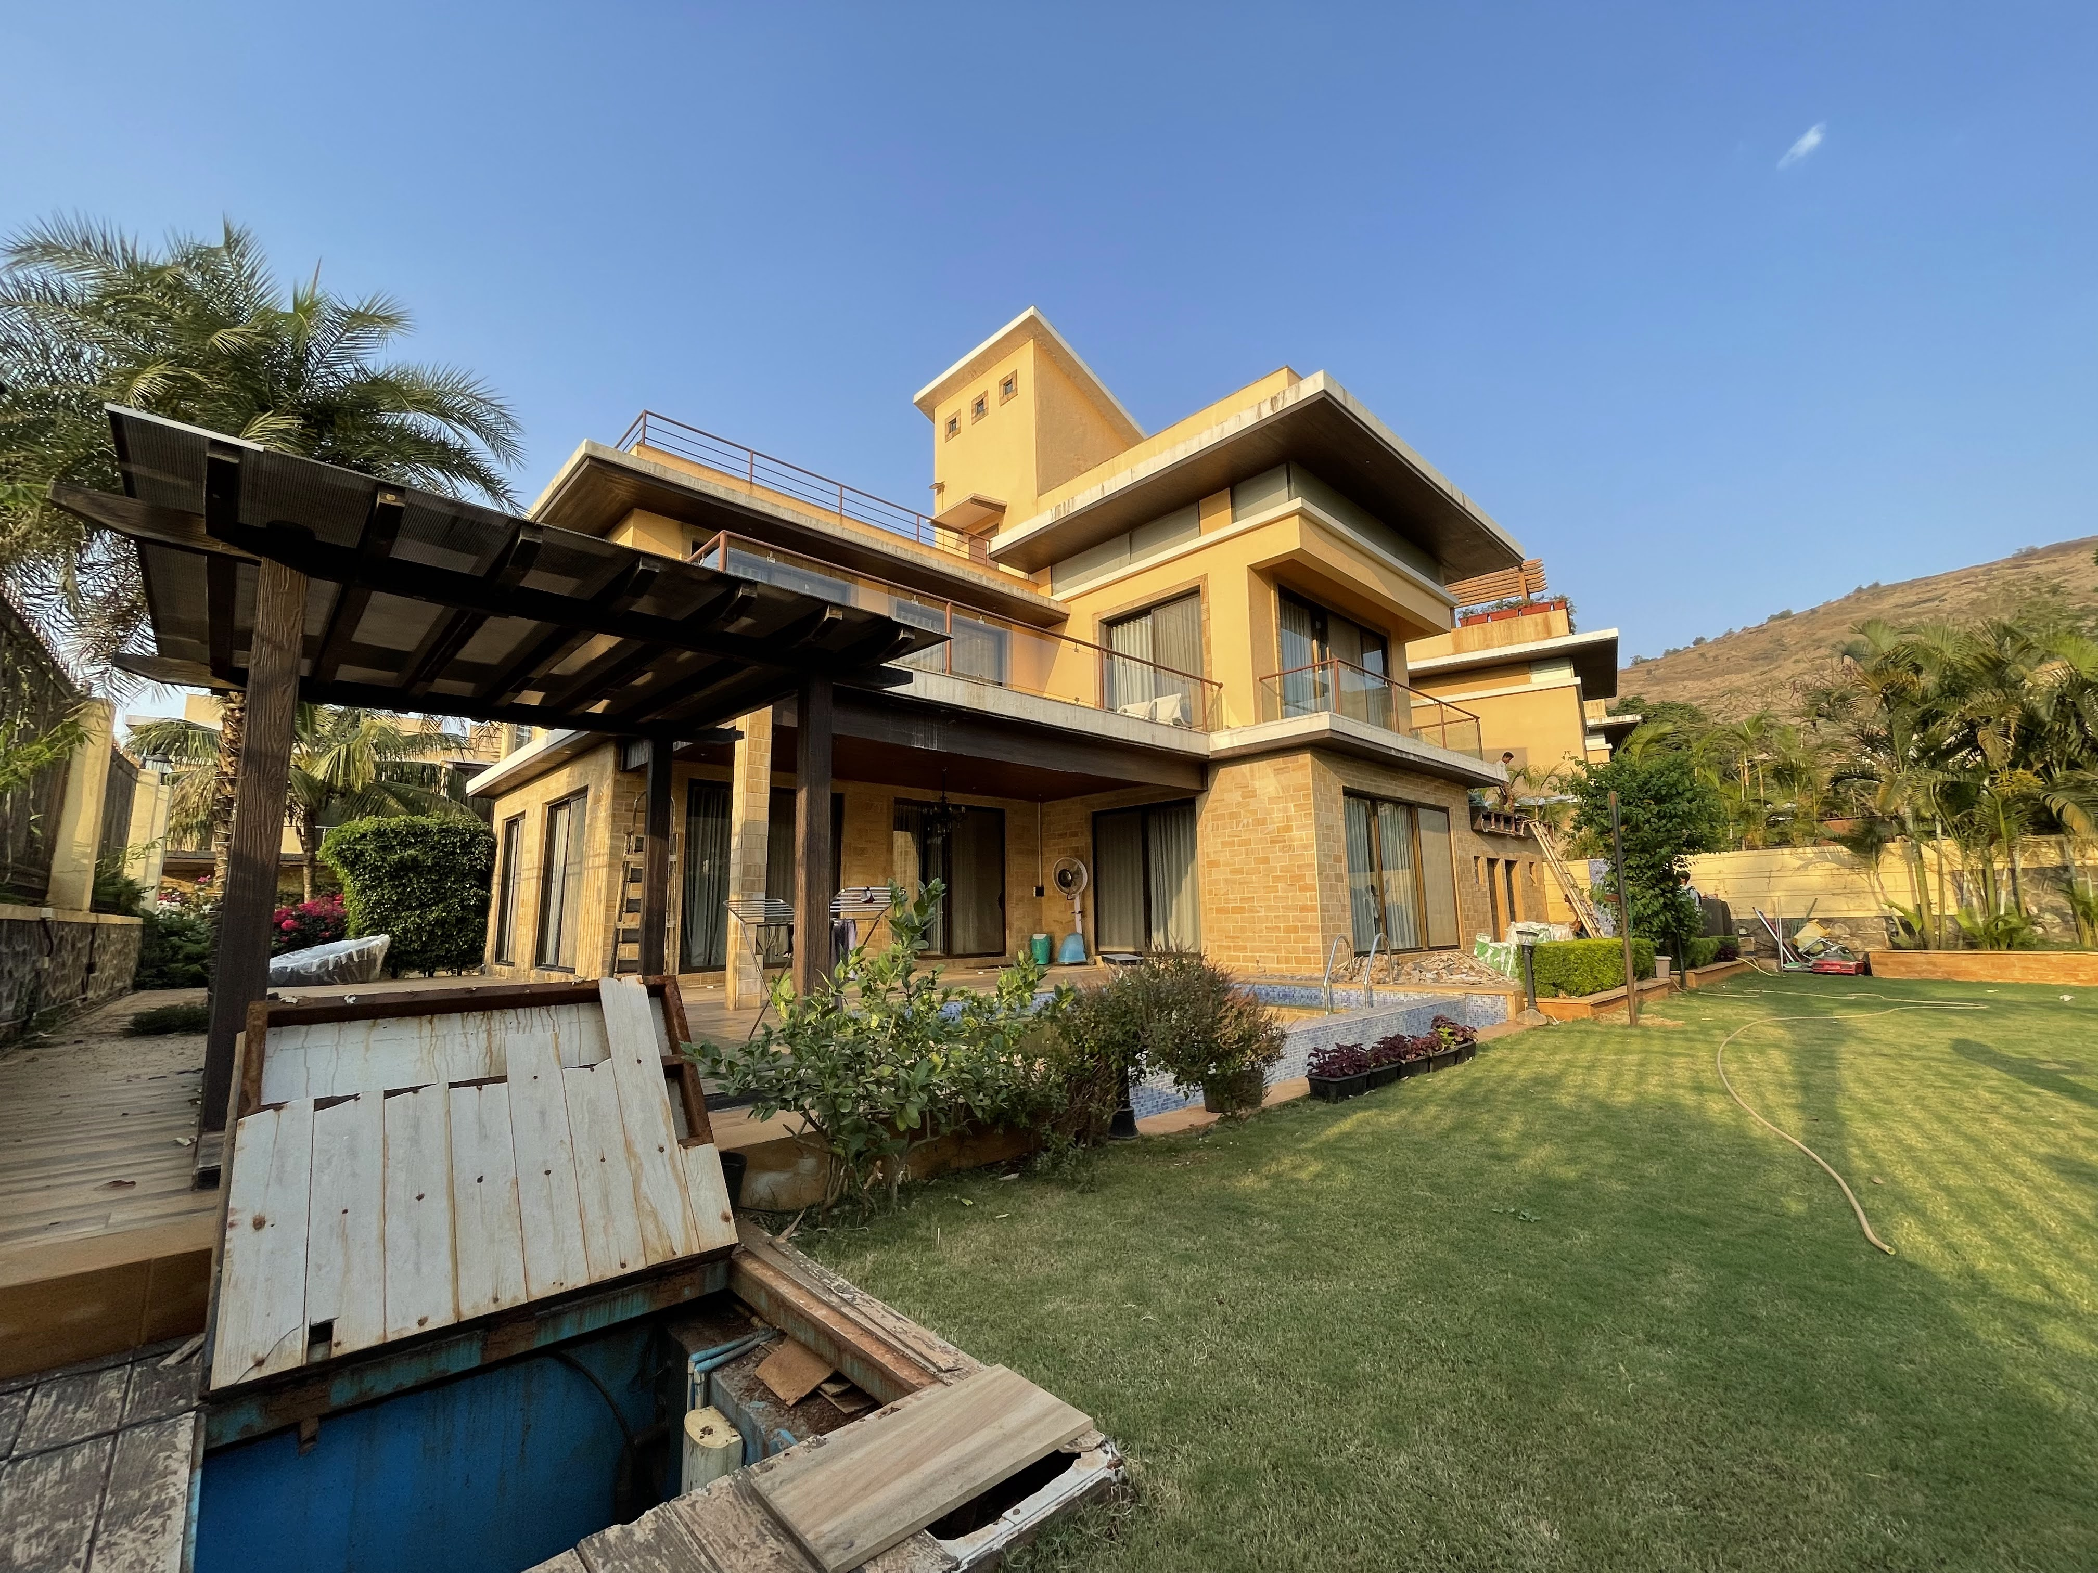
project – b46 della lonavala

Slide 5
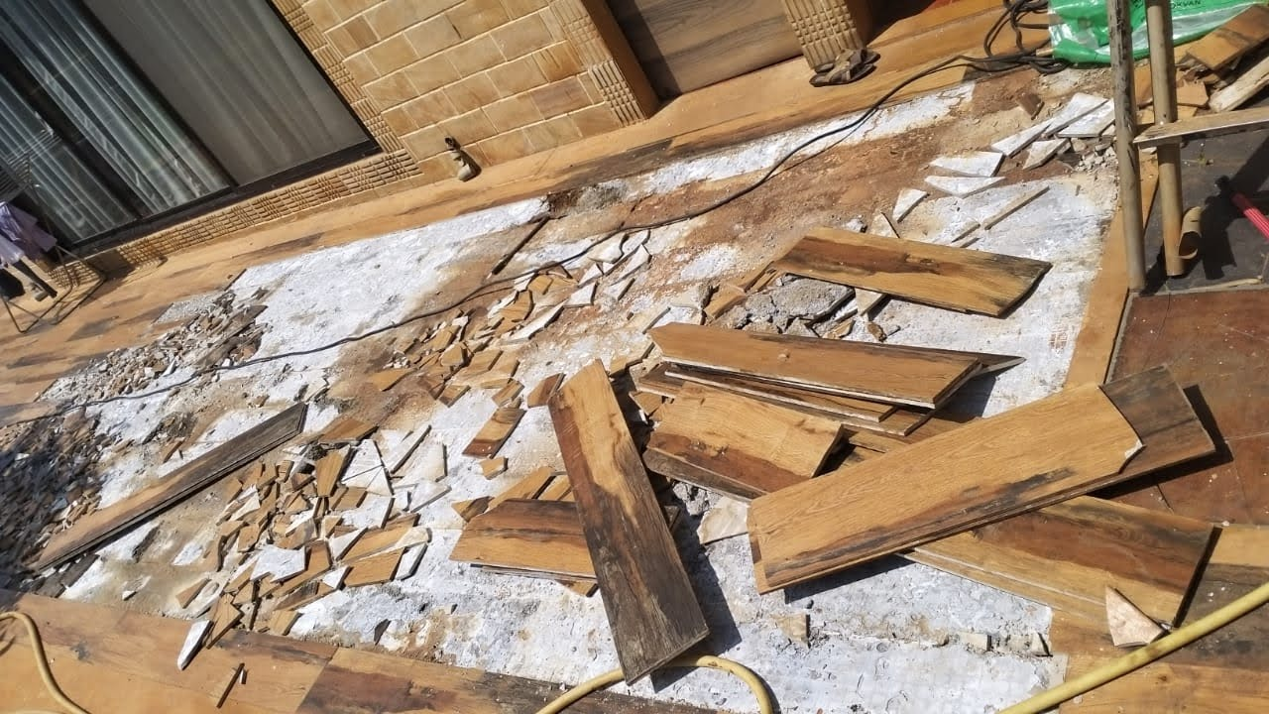
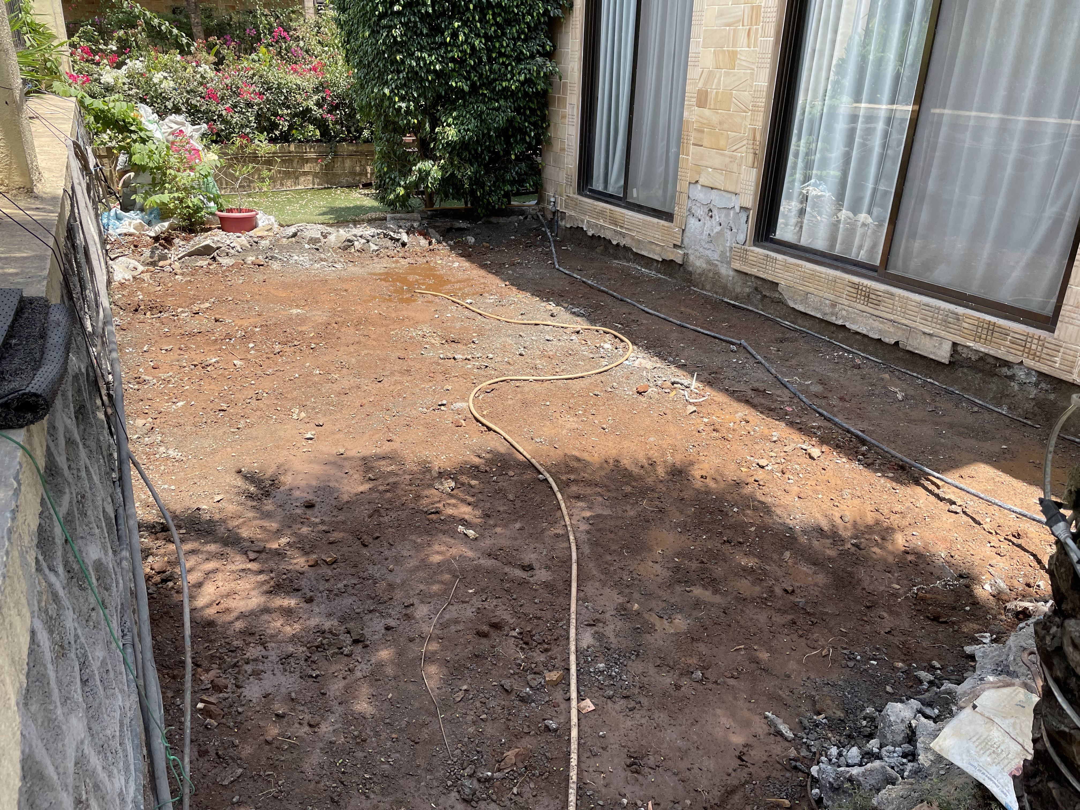
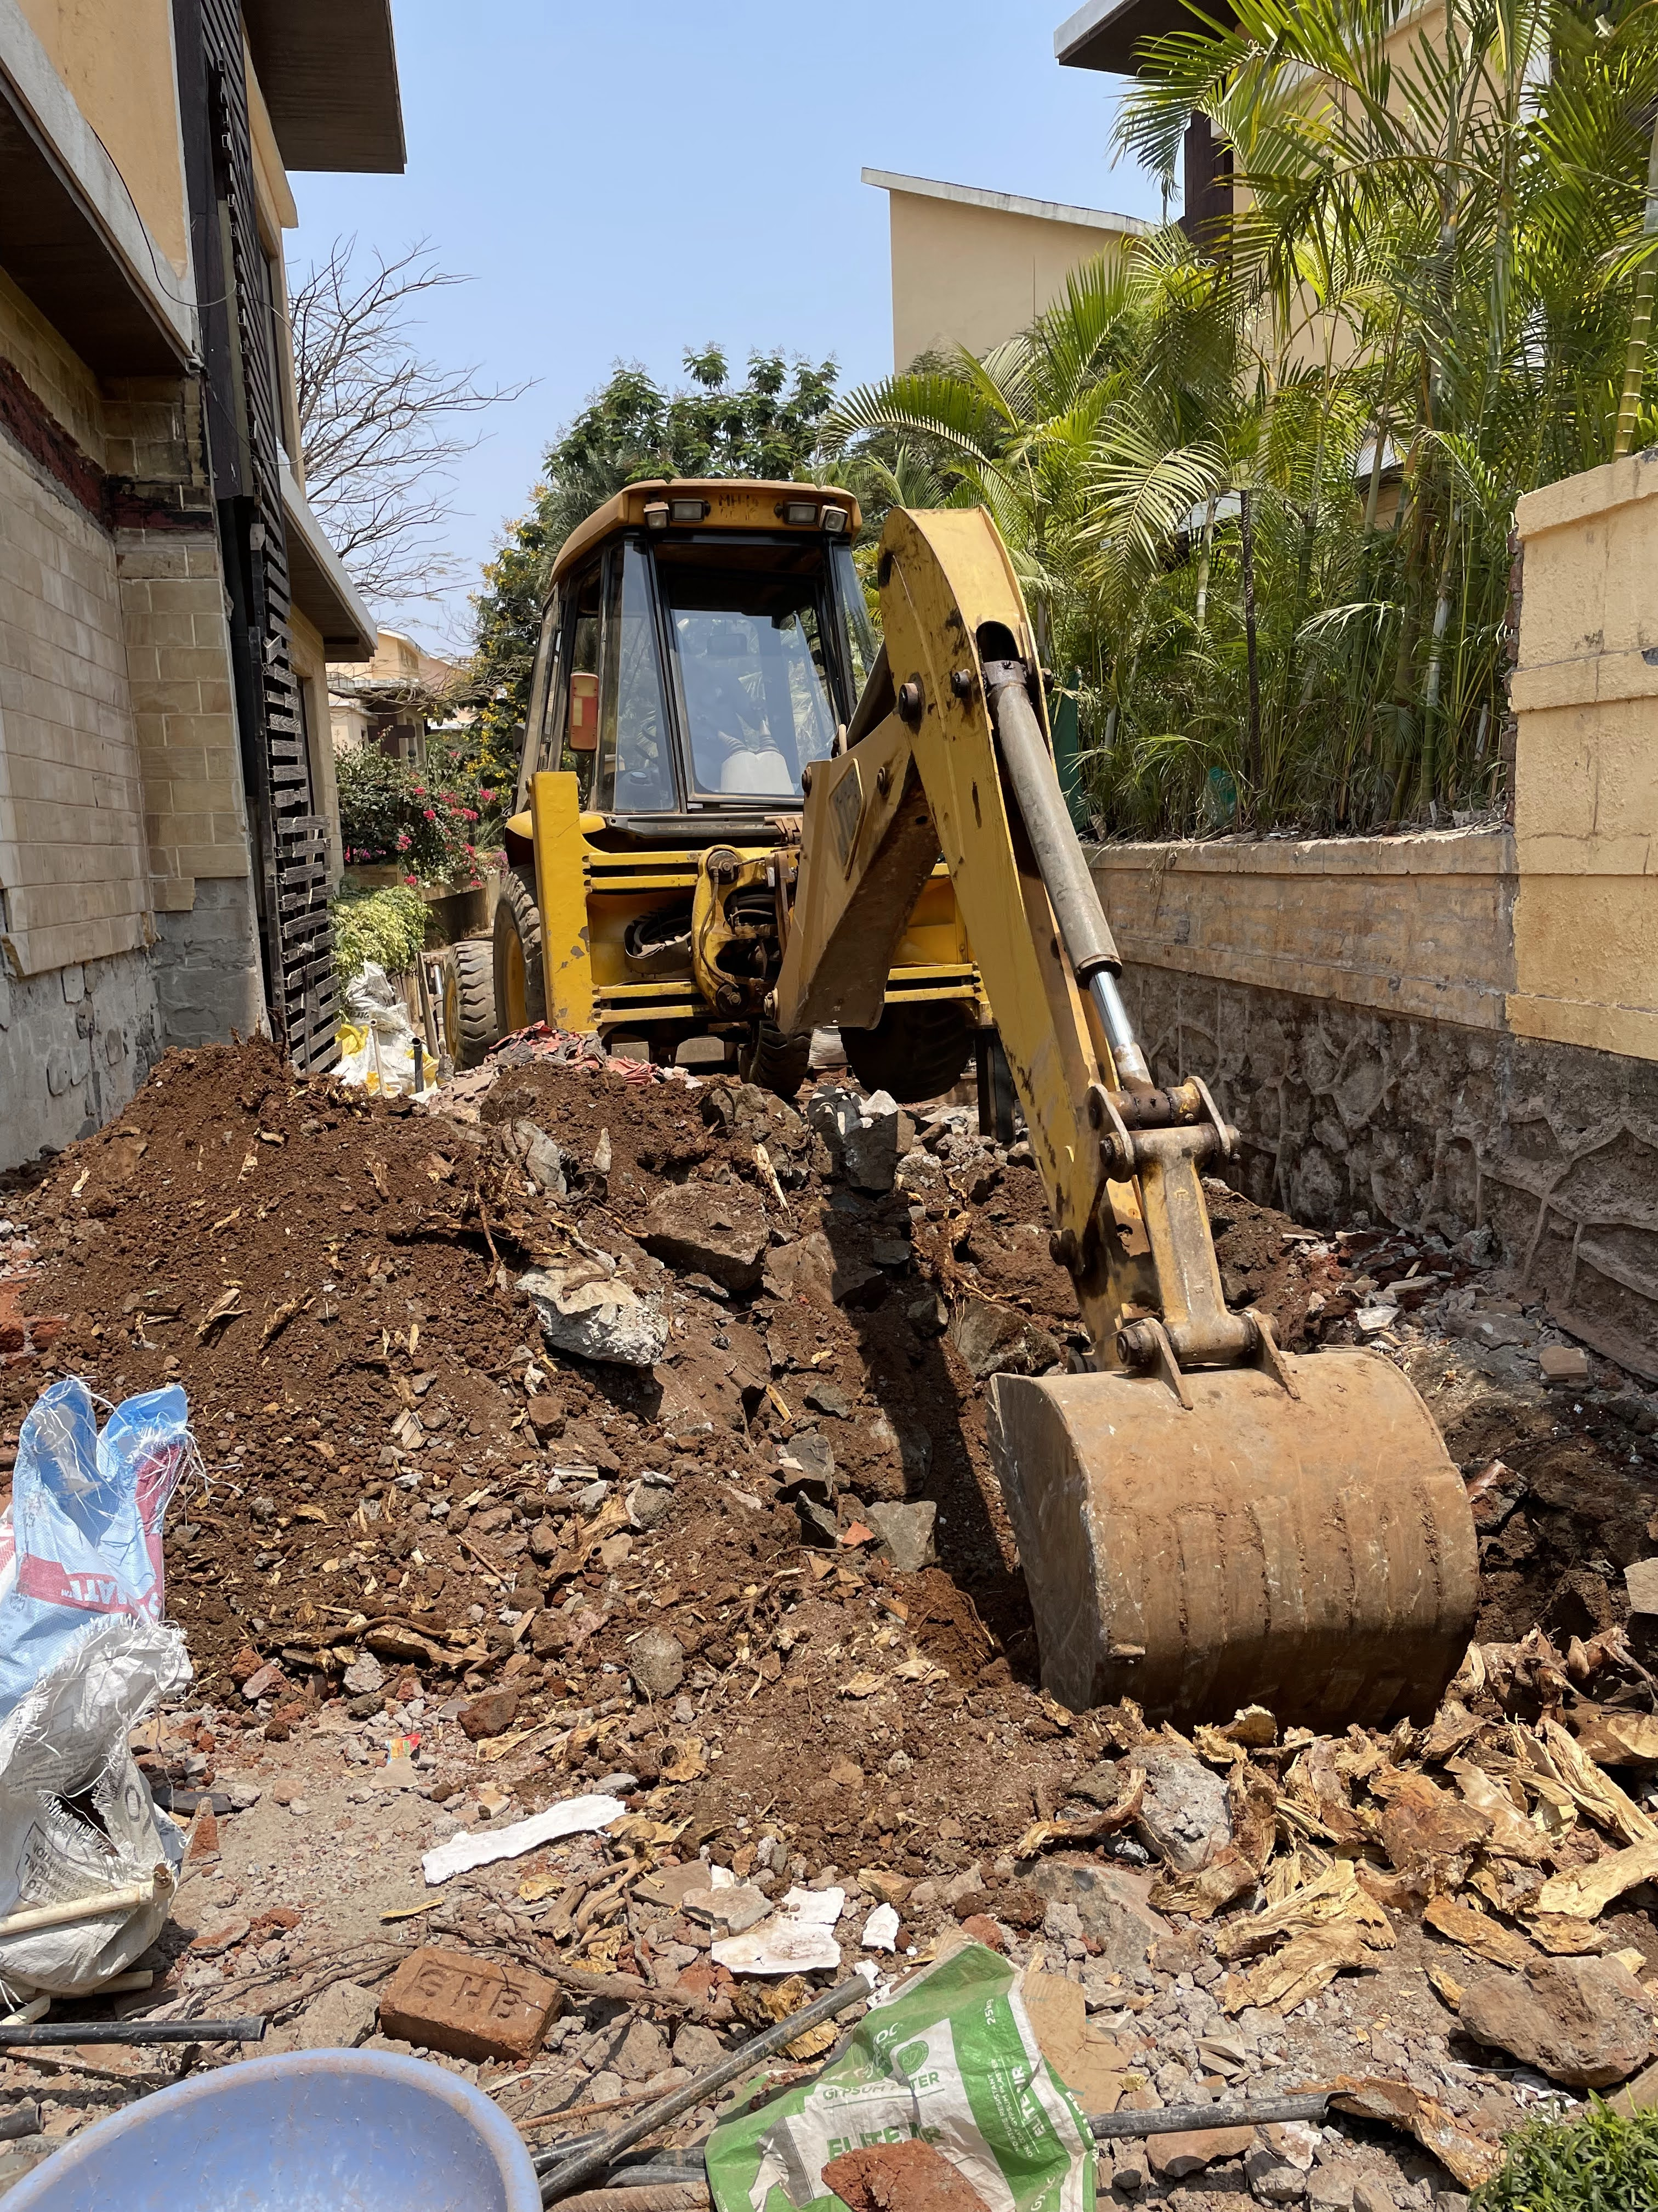
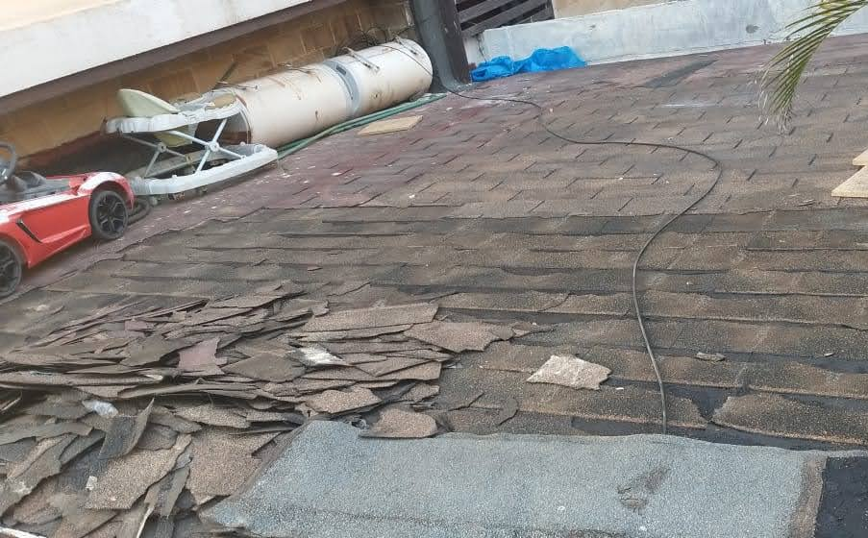
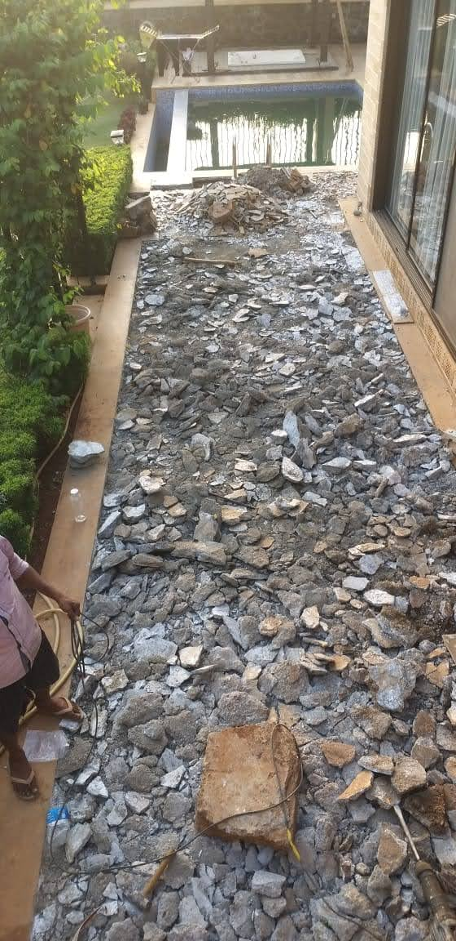
removal of tiles/marble ETC.

Slide 6
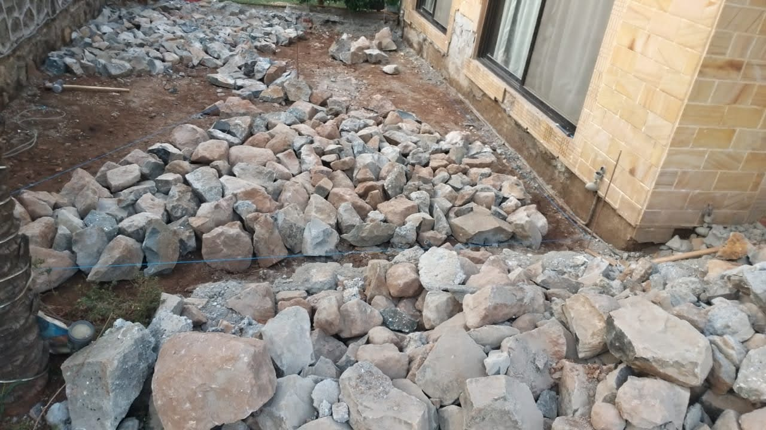
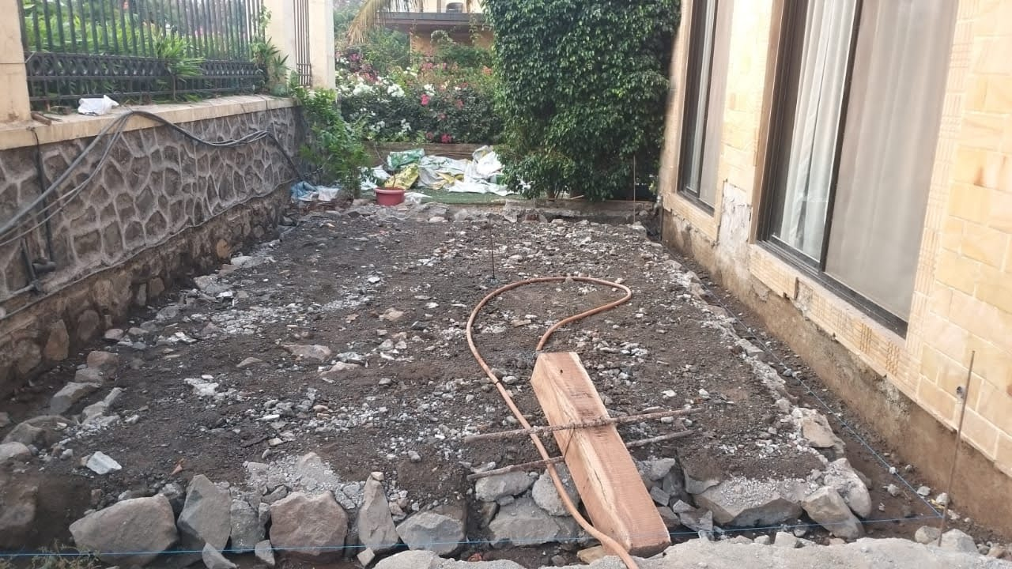
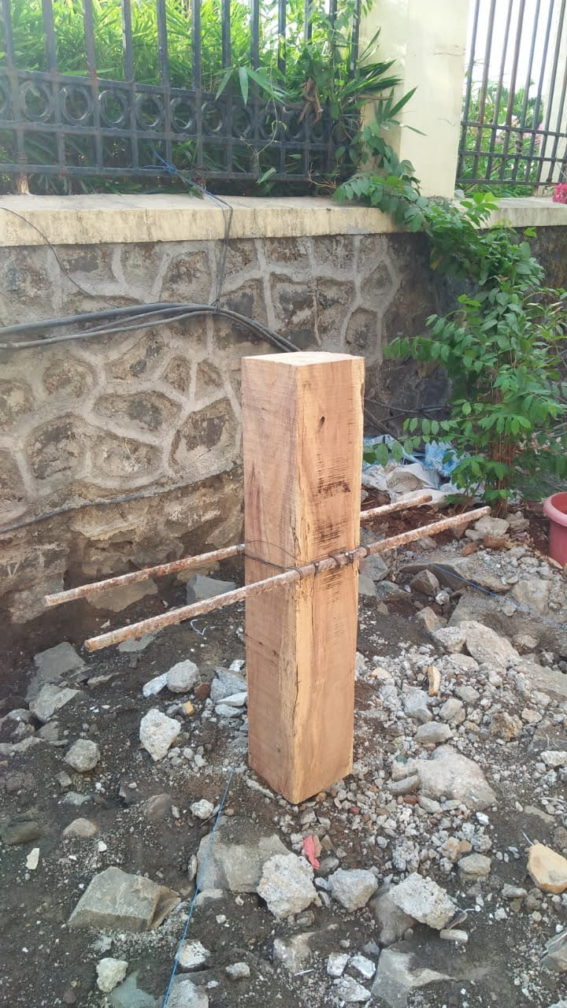
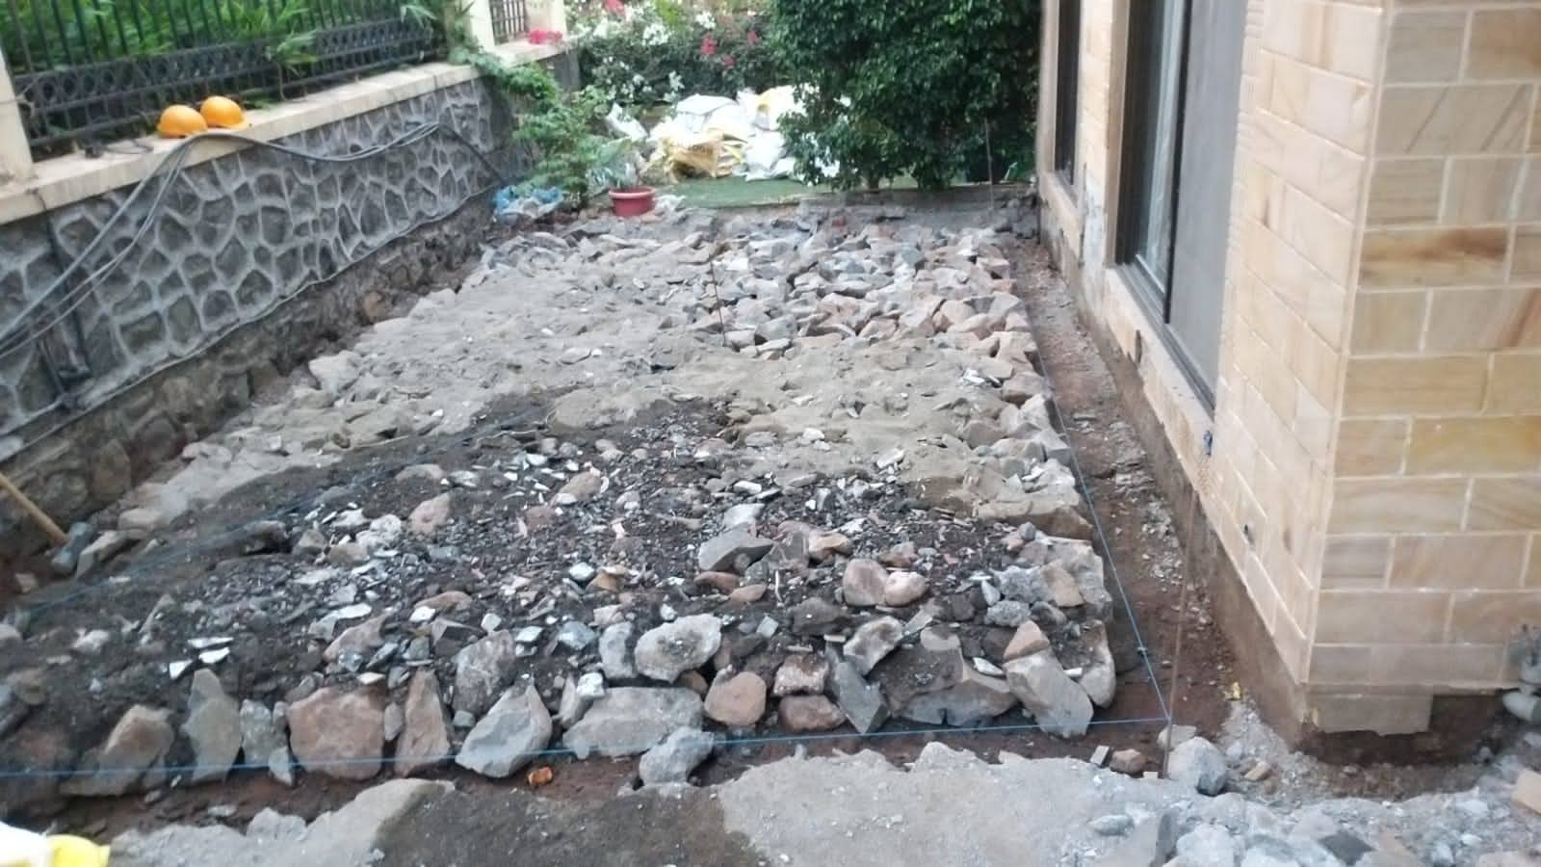
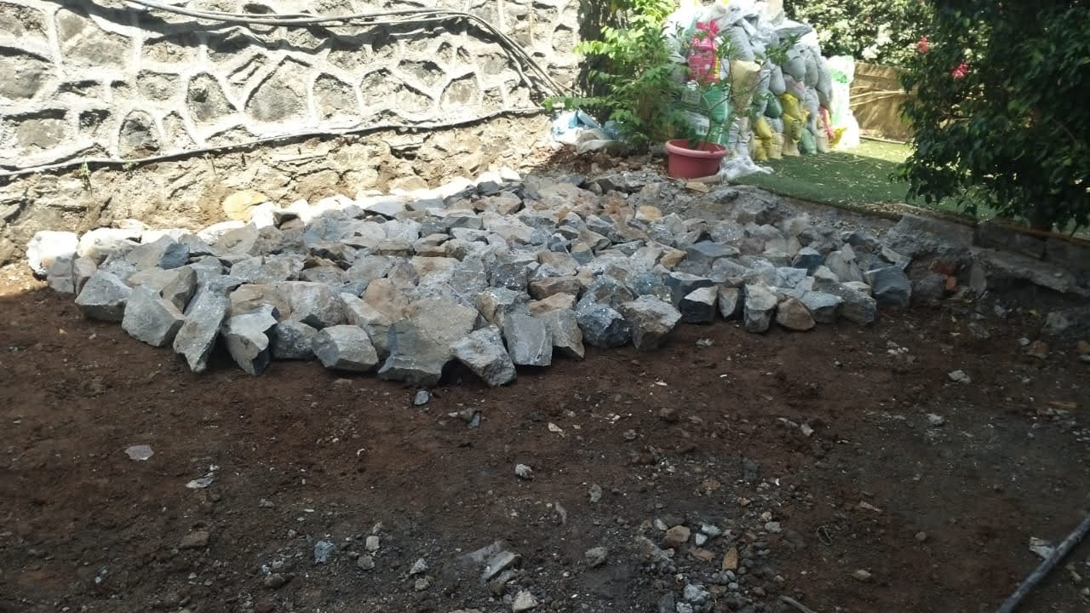
Rubble soling

Slide 7
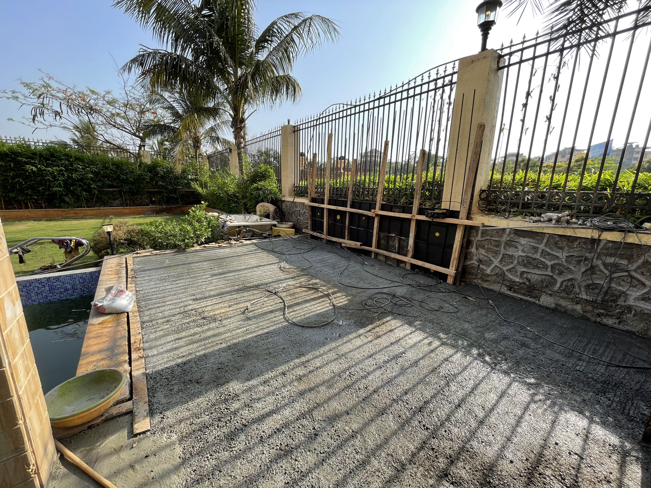
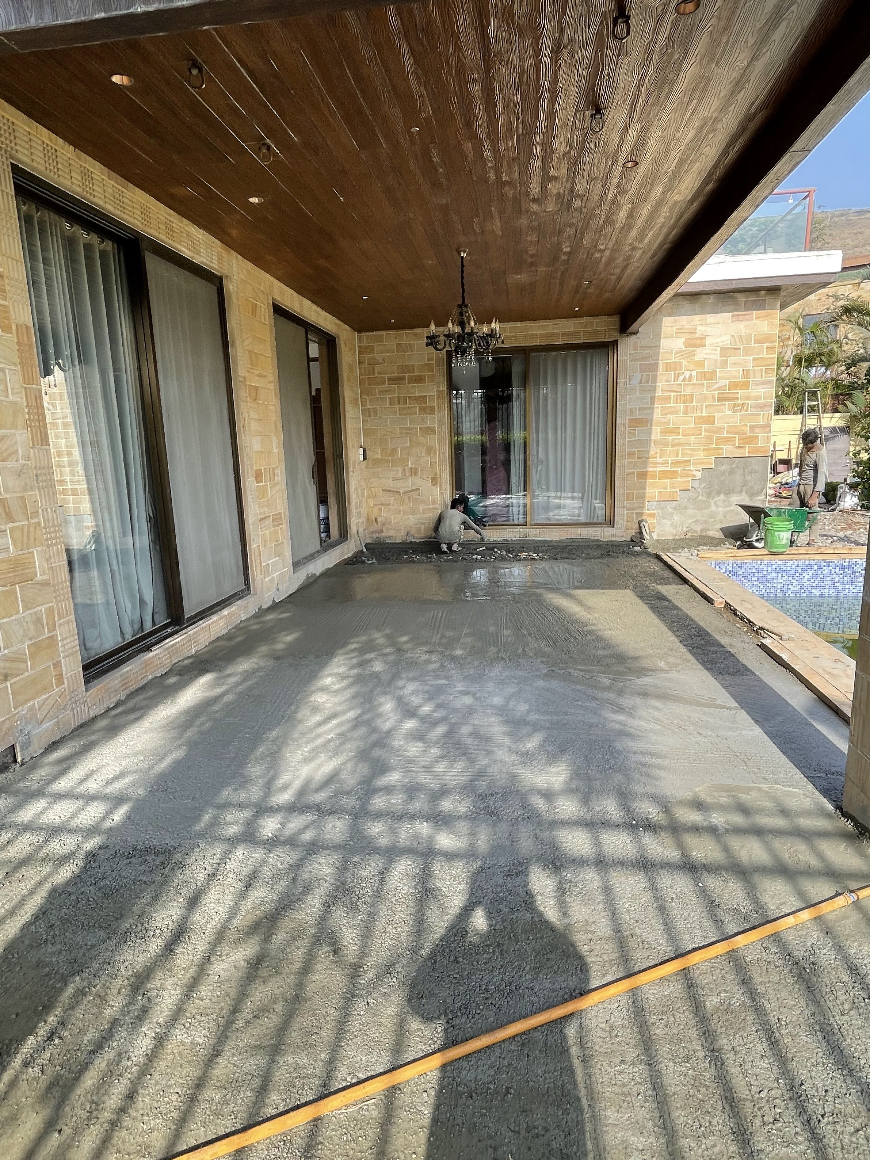
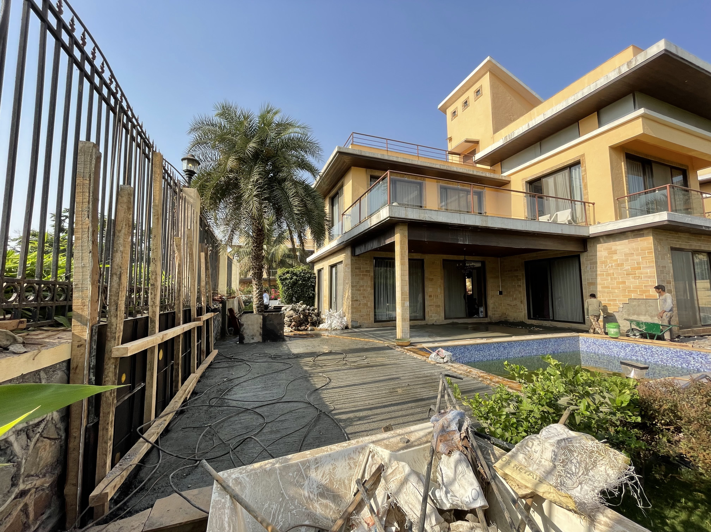
Pcc work

Slide 8
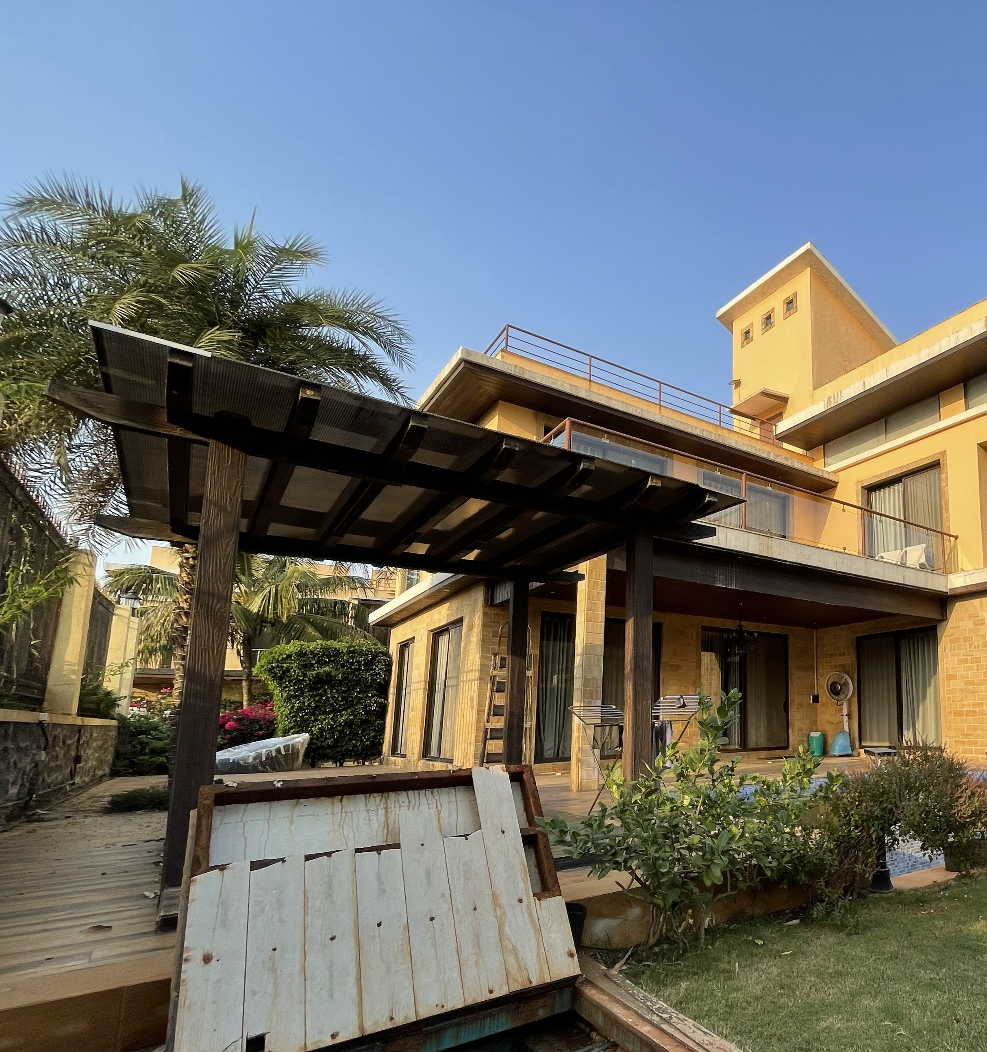
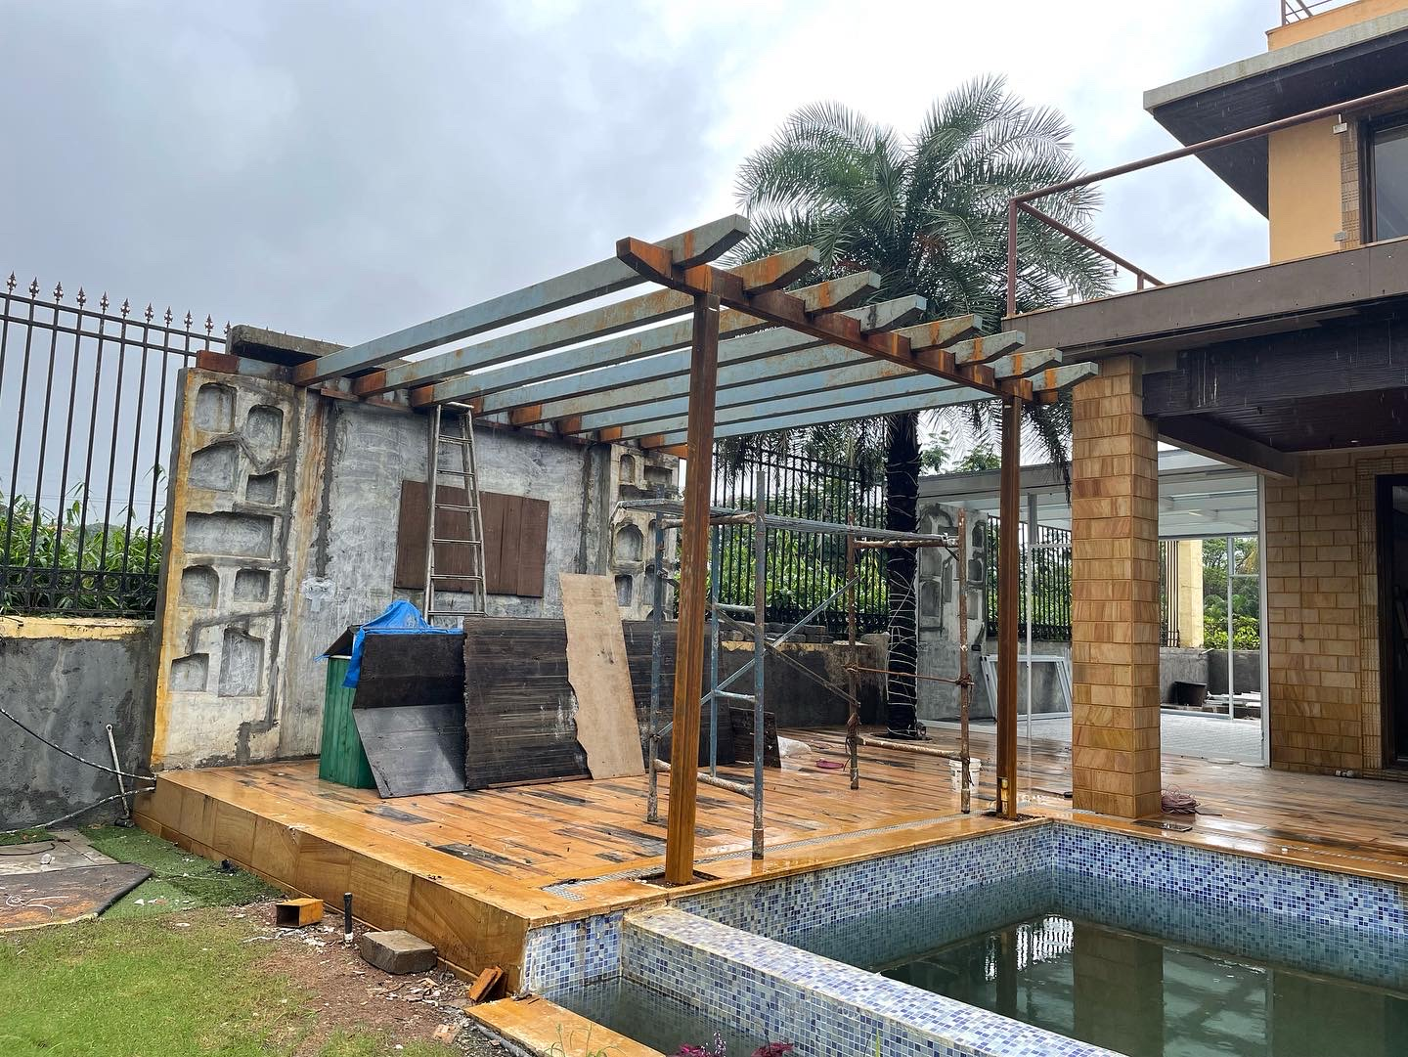
Pergola DESIGN

Slide 9
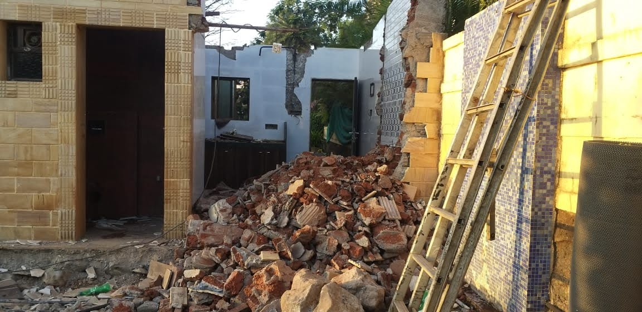
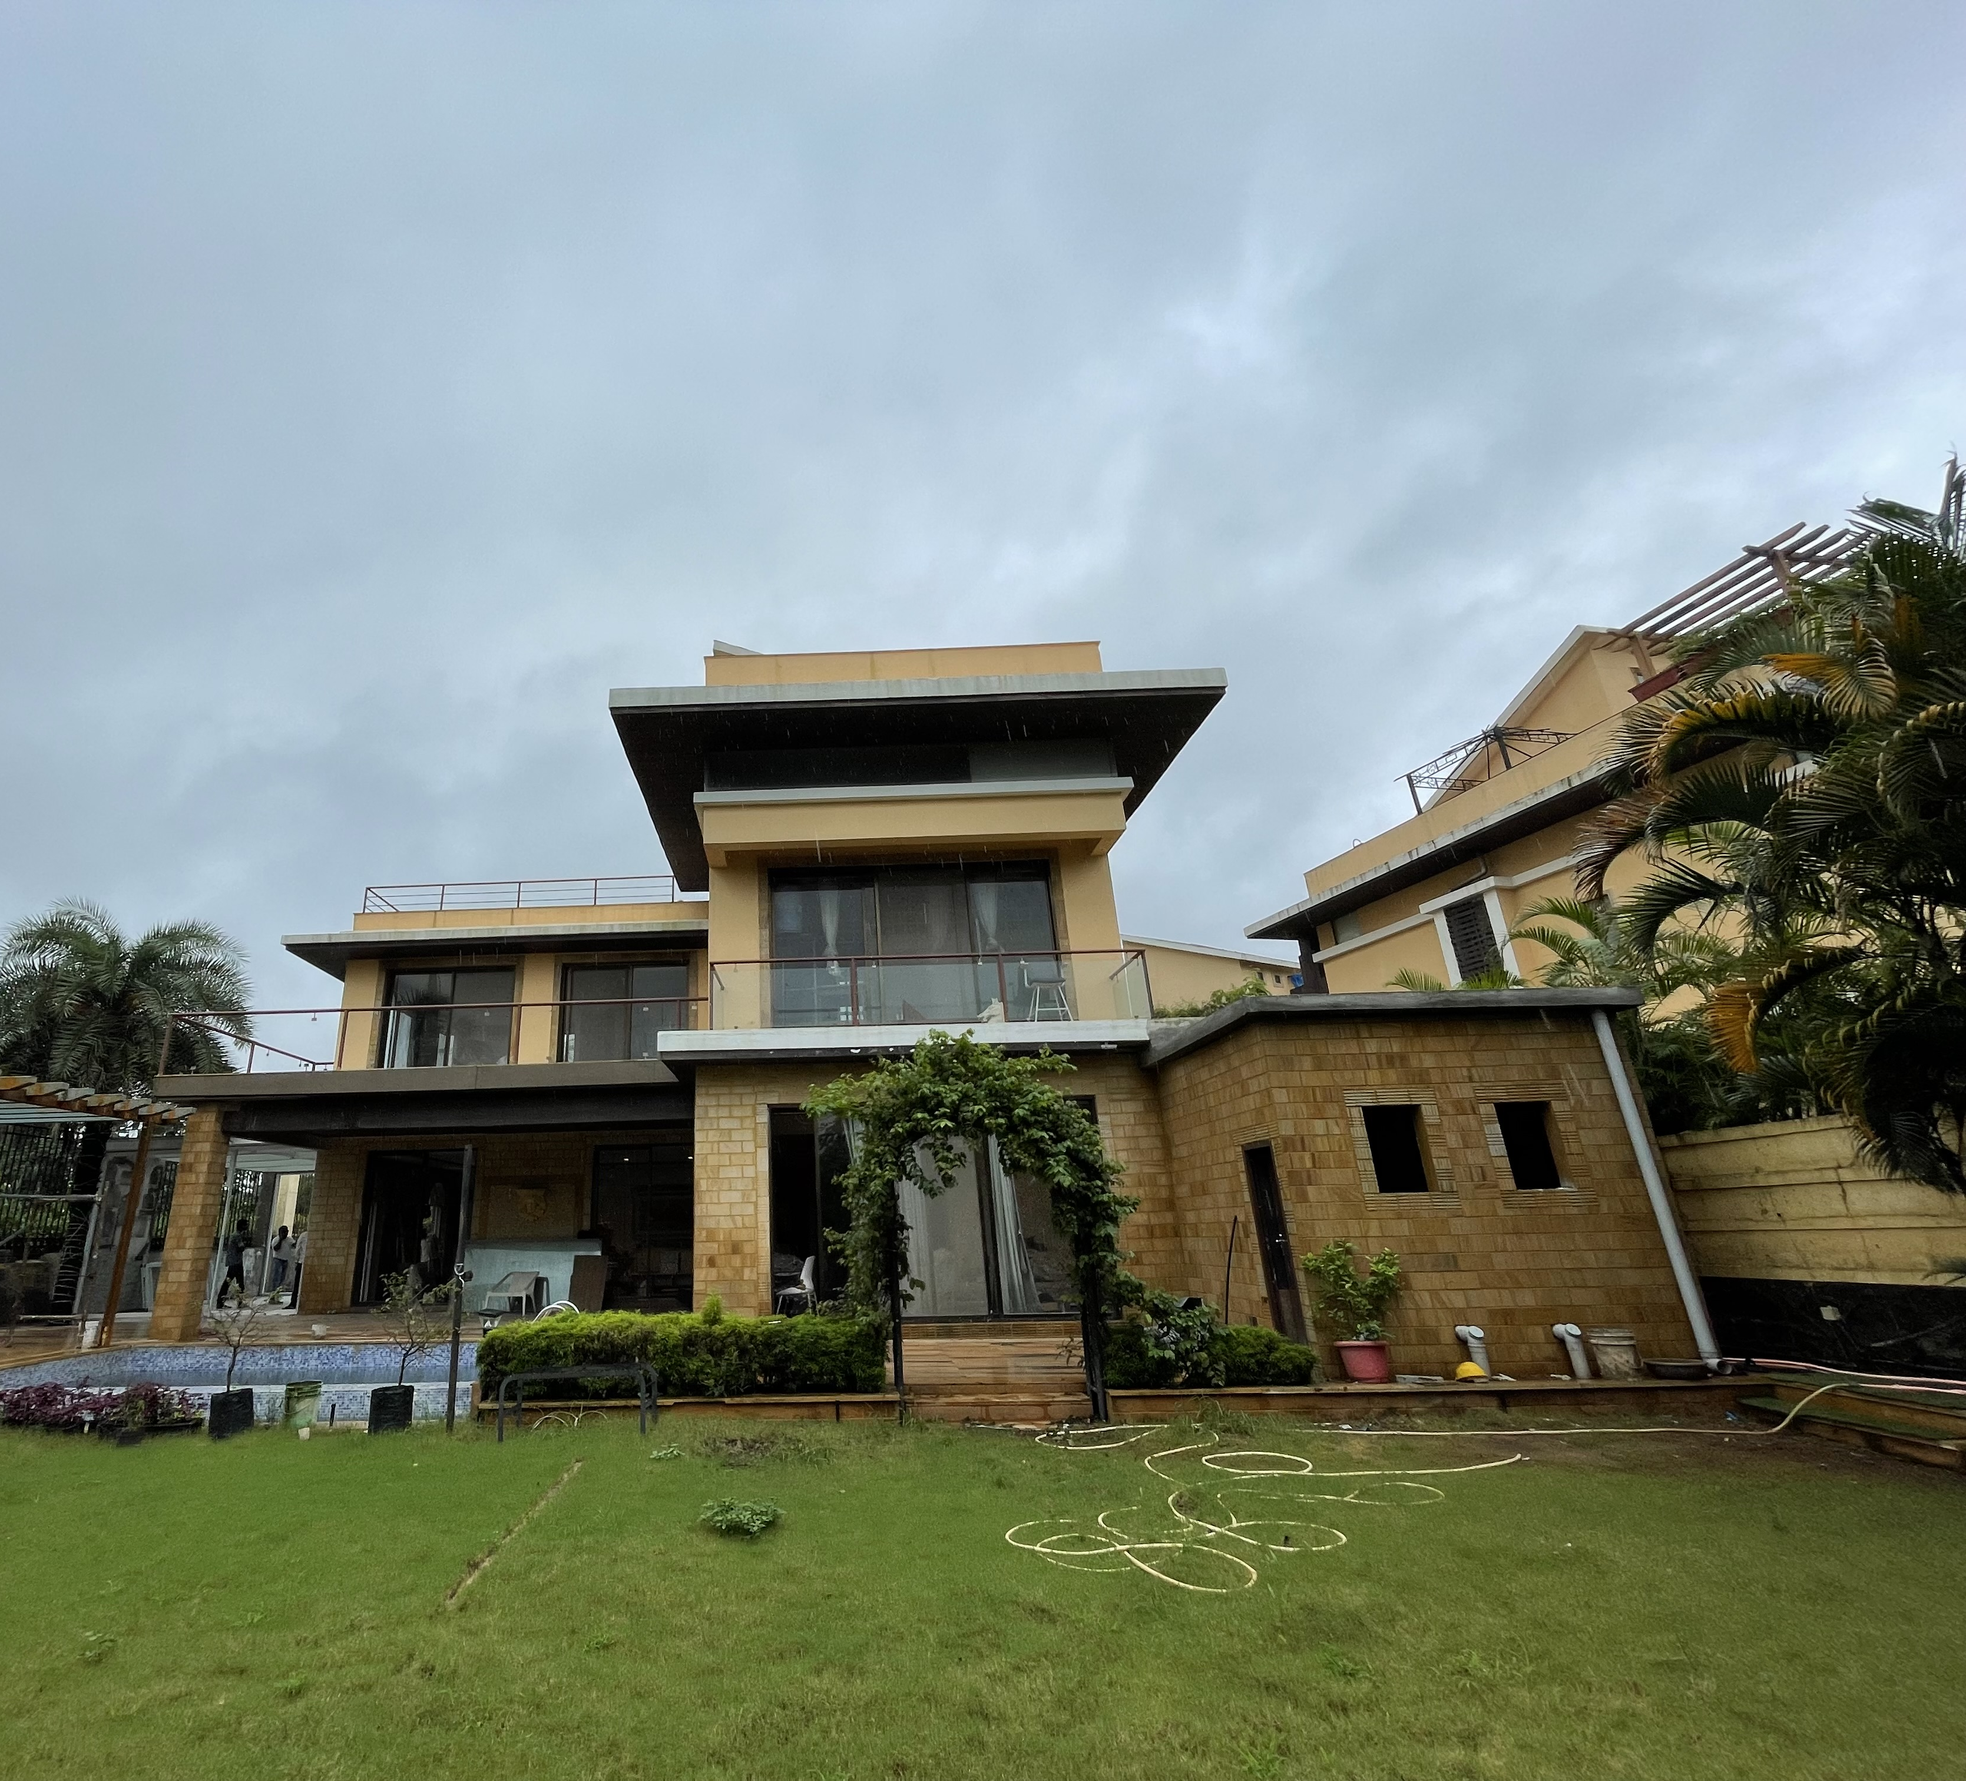
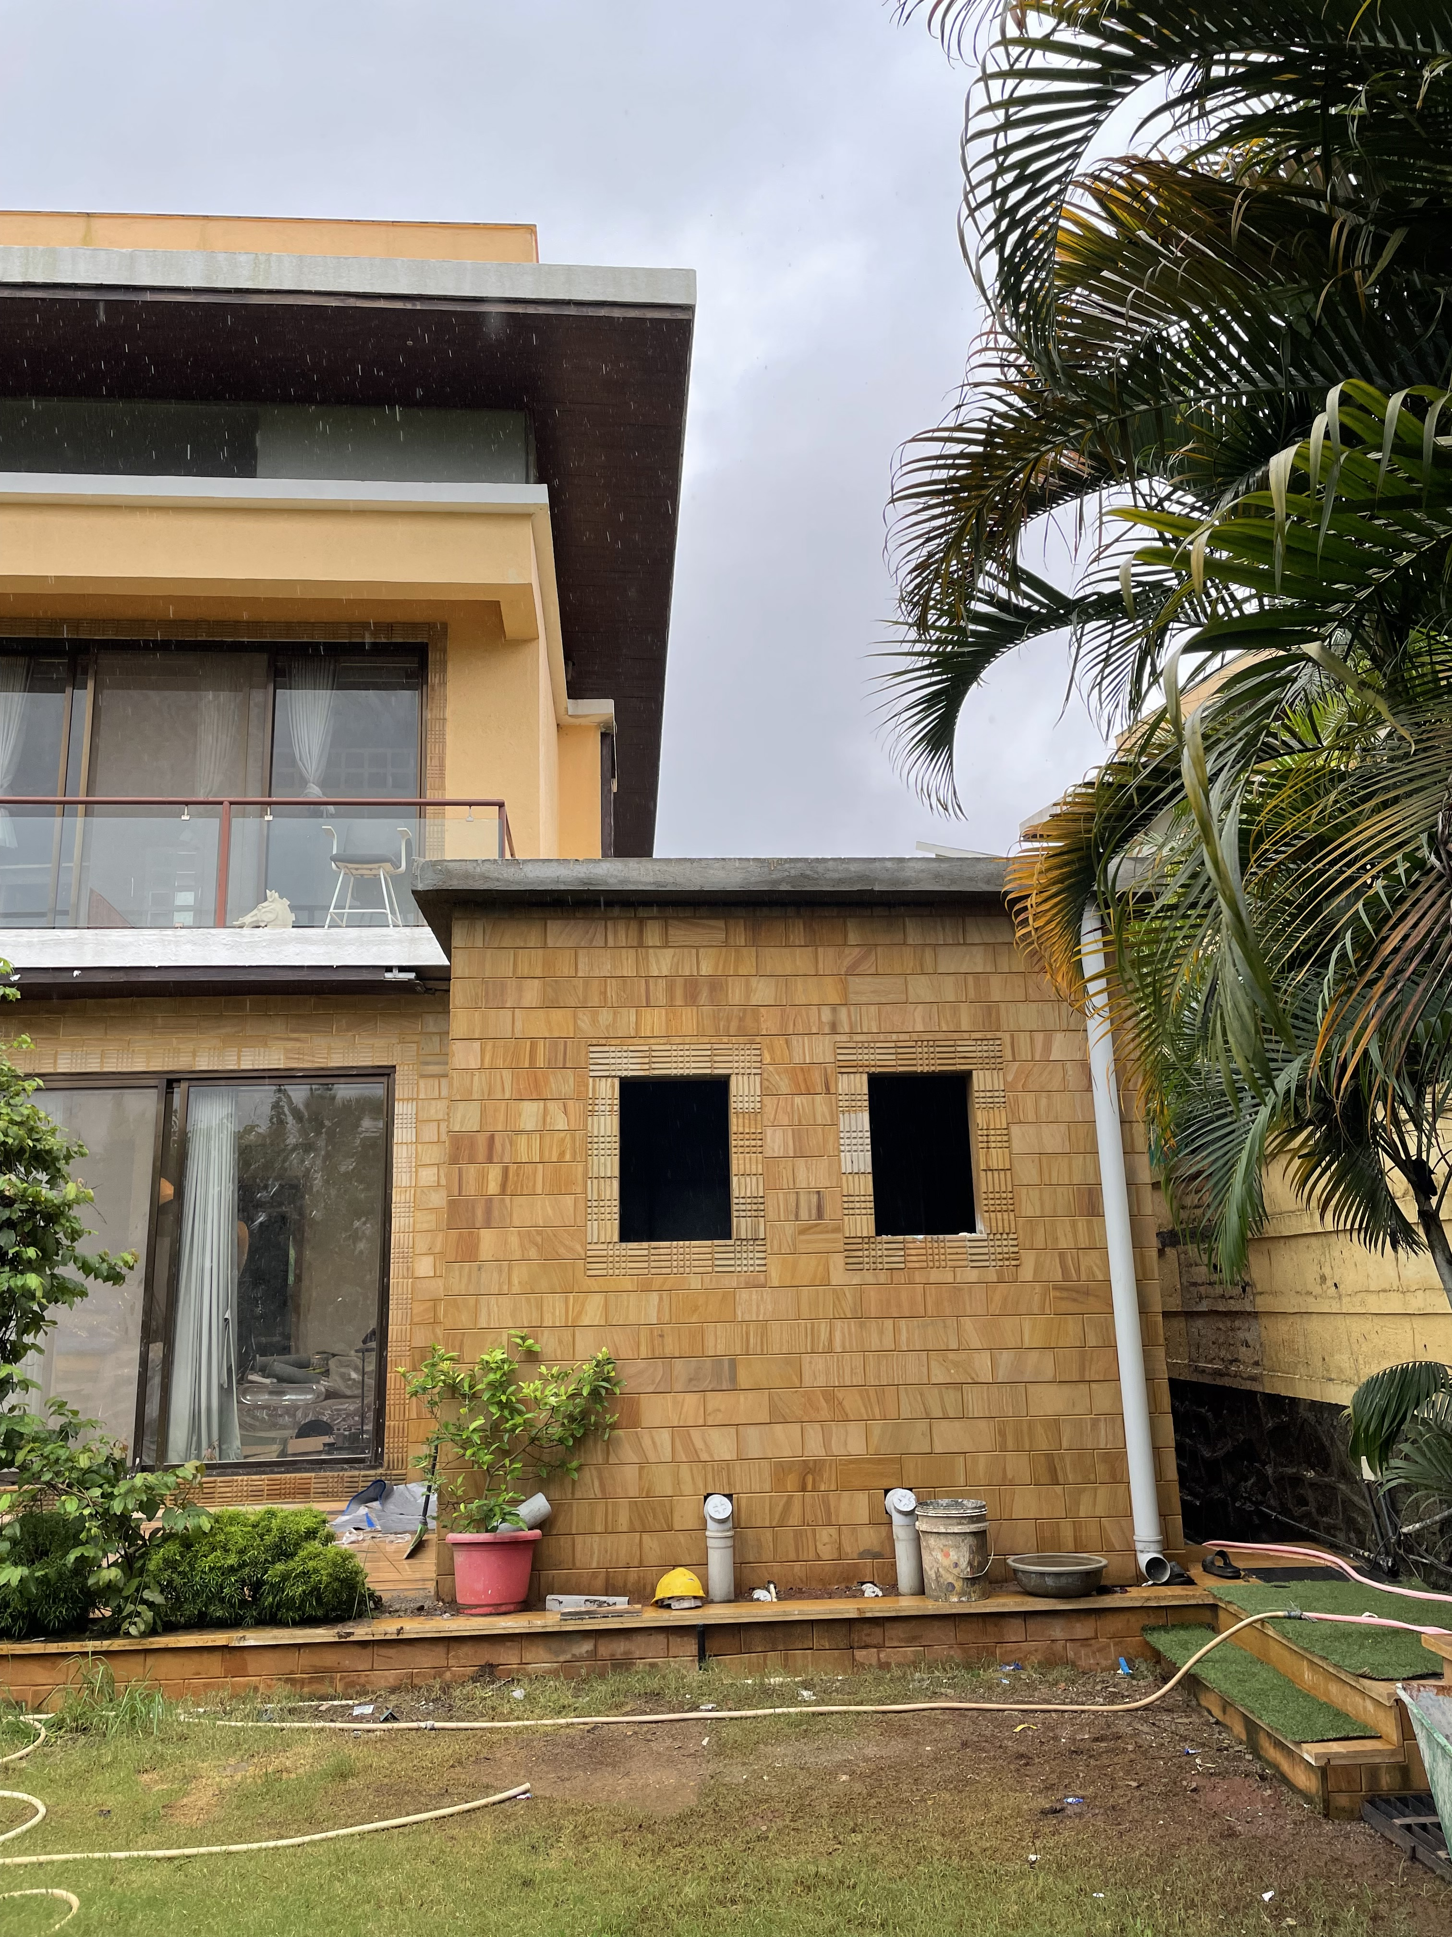
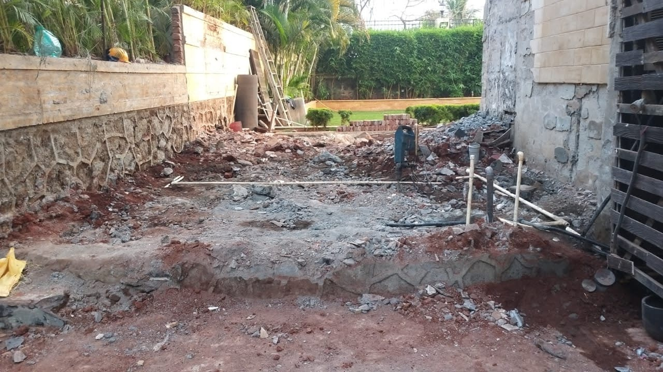
Servant room

Slide 10
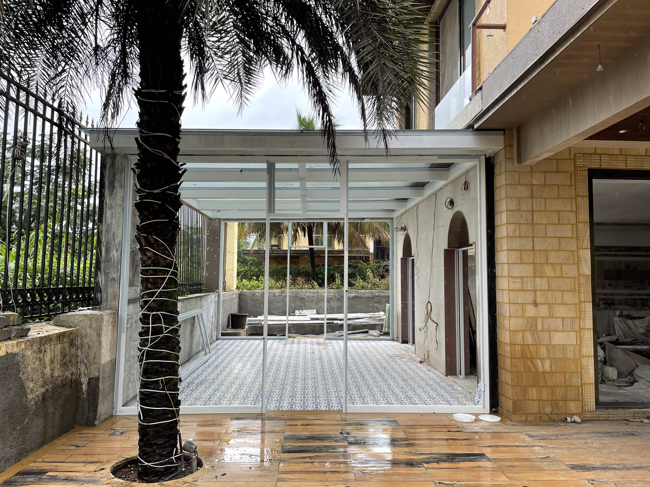
Glass house

